Slide 1
Cloud Computing
SEWP ZG527

Slide 2
Agenda
Virtualization Techniques and Types
Introduction to Virtualization
Use & demerits of Virtualization
Types of Virtualization
- Examples
x86 Hardware Virtualization
2

Slide 3
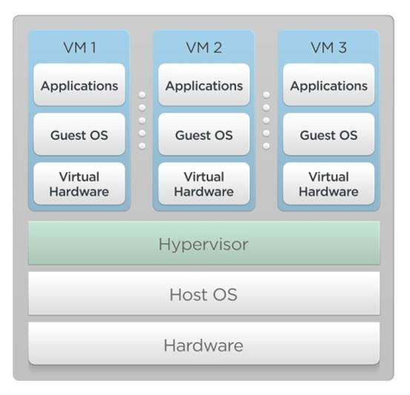
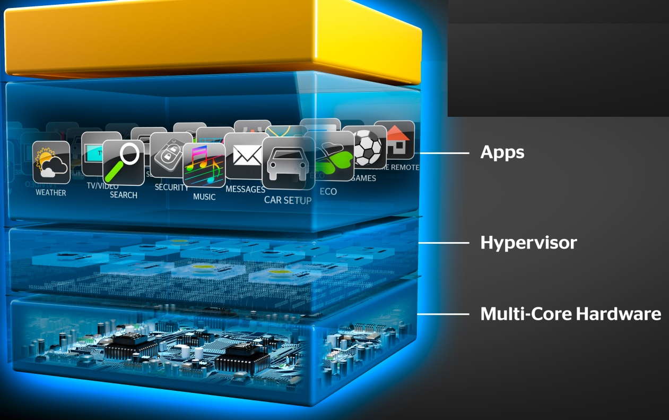
Hypervisor
A thin layer of software that generally provides virtual partitioning capabilities which runs directly on hardware, but underneath higher-level virtualization services. Sometimes referred to as a “bare metal” approach.
Notes:
RL 2.2

Slide 4
Terminologies to remember
Virtualization – System and Process
VMM or Hypervisor
Guest or Virtual machine – Application + OS
Multi-tenancy, Concurrency

Slide 5
Hypervisor Design Goals
Isolation
Security isolation
Fault isolation
Resource isolation
Reliability
Minimal code base
Strictly layered design
Not extensible
Scalability
Scale to large number of cores
Large memory systems

Slide 6
How Hypervisor goals are achieved?
Partitioning Kernel
“Partition” is isolation boundary
Few virtualization functions; relies on virtualization stack
Very thin layer of software
Microkernel
Highly reliable
Basis for smaller Trusted Computing Base (TCB)
No device drivers
Drivers run in a partition
Well-defined interface
Allow others to create support for their OSes as guests

Slide 7
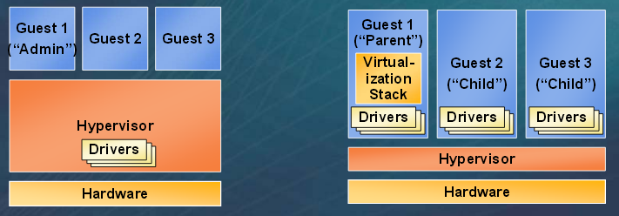
Hypervisor
Monolithic versus Microkernelized
Monolithic hypervisor
Simpler than a modern kernel, but still complex
Contains its own drivers model
Microkernelized hypervisor
Simple partitioning functionality
Increase reliability and minimize lowest level of the TCB
No third-party code
Drivers run within guests

Slide 8
Terminologies to remember
Types of Hypervisors – Bare metal or native – VMWare ESX
Hosted hypervisors – VMWare GSX
Hybrid hypervisors – MS Hyper-V, Xen

Slide 9
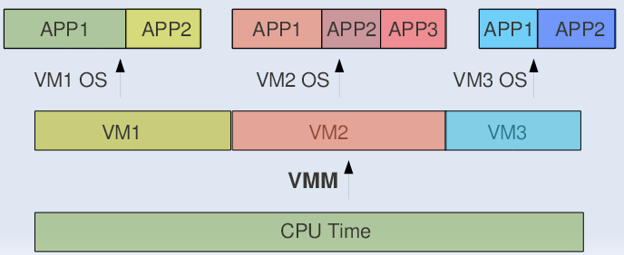
CPU Sharing
VMM or Hypervisor provides a virtual view of CPU to VMs.
In multi processing, CPU is alloted to the different processes in form of time slices by the OS.
Similarly VMM or Hypervisor allots CPU to different VMs.

Slide 10
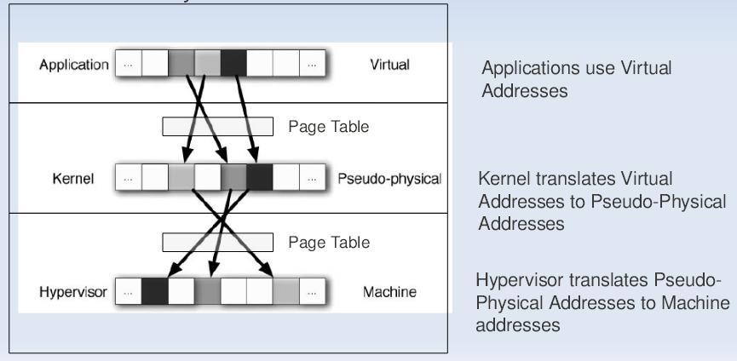
Memory Sharing
In Multiprogramming there is a single level of indirection maintained by Kernel.
In case of Virtual Machines there is one more level of indirection maintained by VMM

Slide 11
IO Sharing
Device needs to use Physical Memory location.
In a virtualized environment, the kernel is running in a hypervisor-provided virtual address space
Allowing the guest kernel to convey an arbitrary location to device for writing is a serious security hole
Each device defines its own protocol for talking to drivers

Slide 12
Thanks!!!
Queries?

